Slide 1
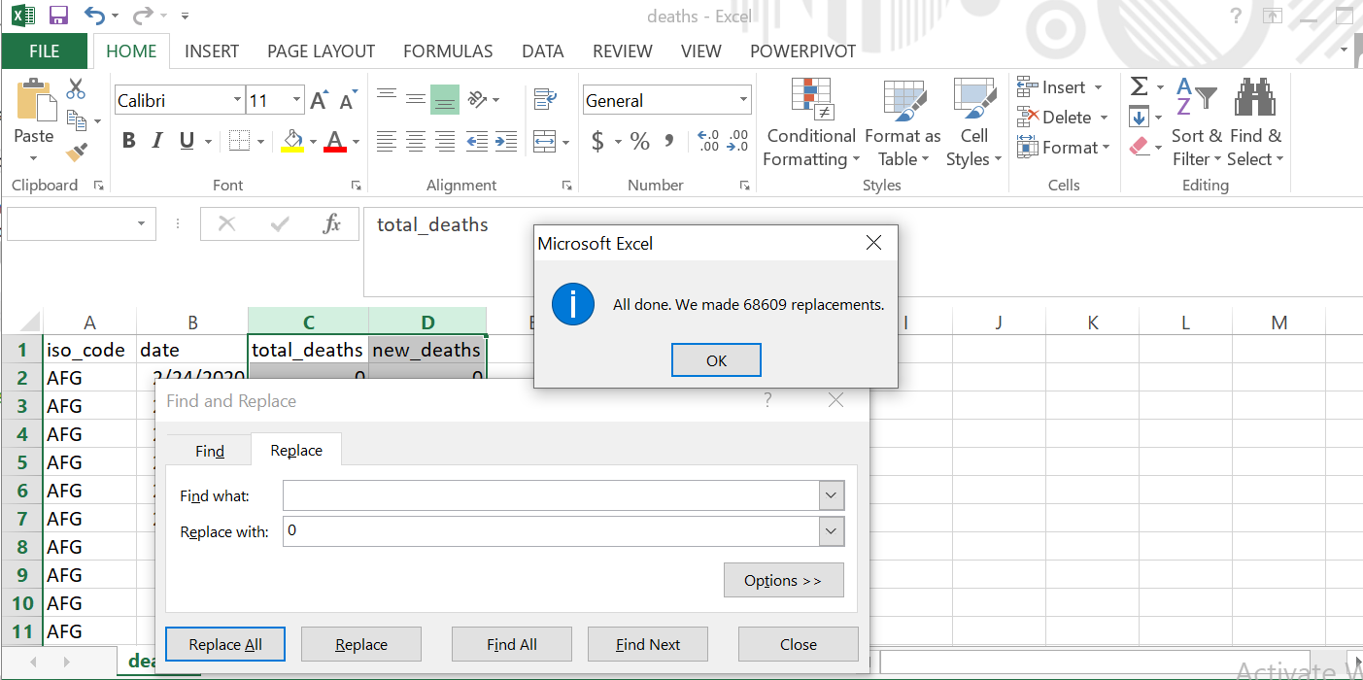
If you're getting a type error while loading data, you're probably having trouble with null fields.
Replace null int values with 0 with find replace option in excel.

Slide 2
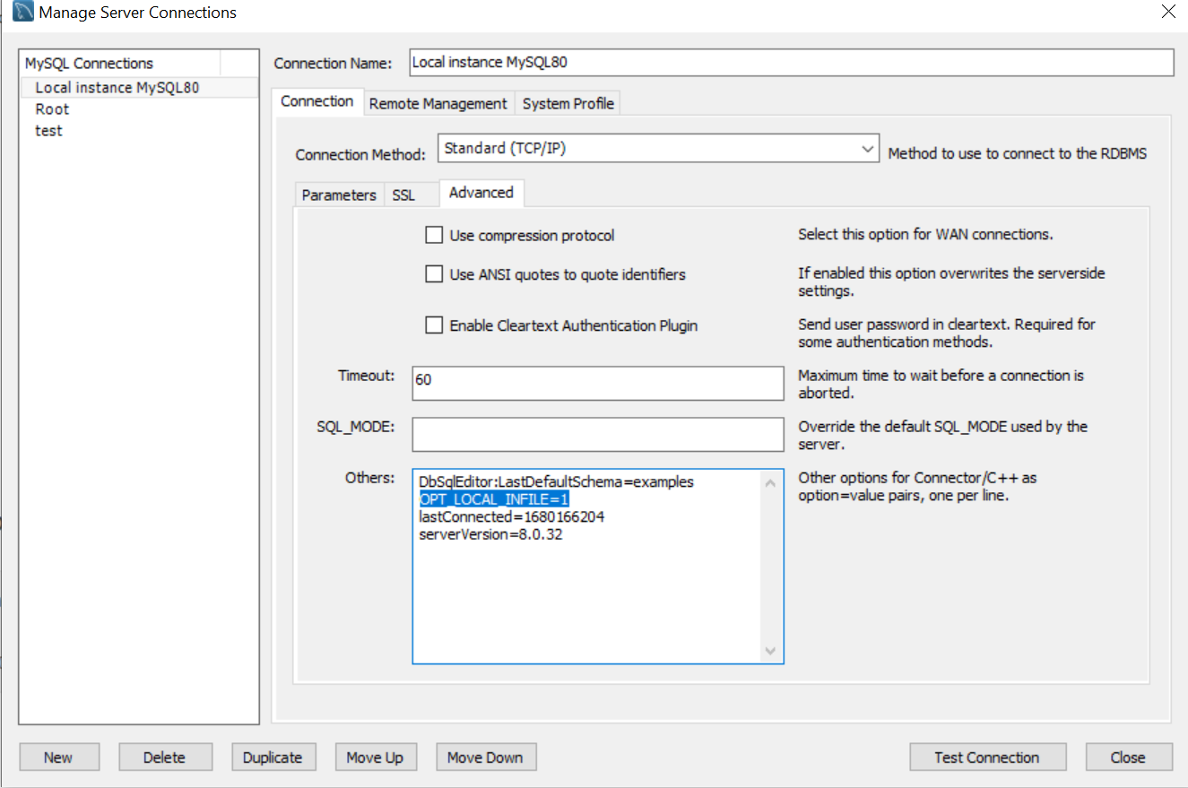
If you are having problems with the load data infile command, you need to go to MySQL home and edit the connection and add "OPT_LOCAL_INFILE=1" in the connection advanced others section.

Slide 3
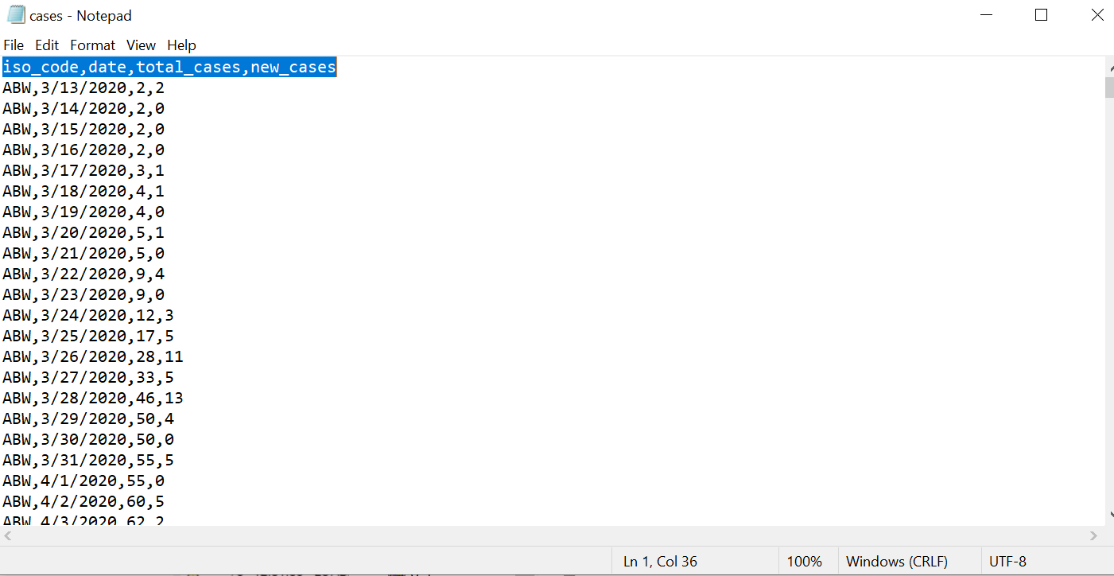
Also, in order to use the load data infile command without error, you need open file in notepad and delete the header in your csv file and the space that excel added at the end of the file.

